Slide 1

Removal of Trace Organics through Photolysis for Water Reuse
Alec Nienhauser
Mentored by: Itzel Marquez and Eduardo Saez
Department: Chemical and Environmental Engineering
Institution: The University of Arizona
Notes:
Larger Fonts

Slide 2
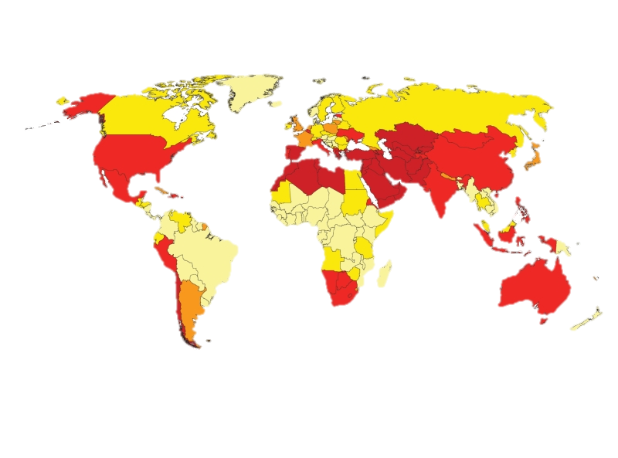

Water Stress Levels by 2040
Ratio of withdrawals to supply
Low (<10)
Low to Medium (20-40)
High (40-80)
Extremely High (>80)
Notes:
% of renewable water consumed/year

Slide 3
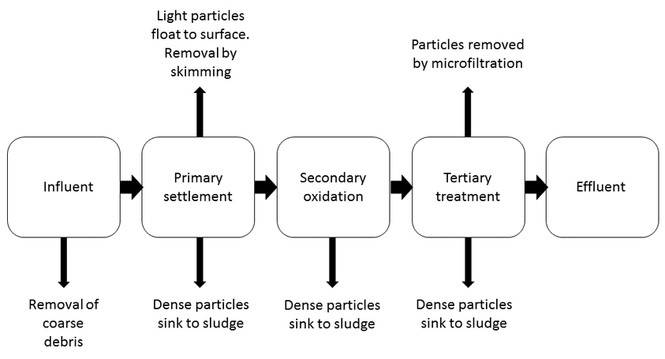
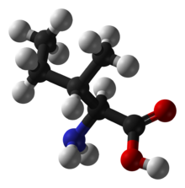
Solution: Water Reuse
Pharmaceuticals
X-Ray Media
Hormones
Per-Fluorinated Compounds
Disinfection Byproducts
Notes:
Solution to water shortage – Wastewater treatment

Slide 4
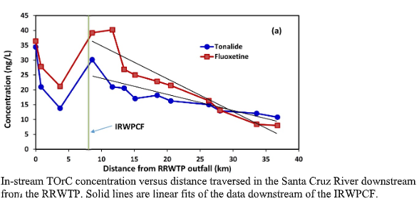

Background: Natural Attenuation of Contaminants in the Effluent in the Santa Cruz River
Bulleted Paragraph
  Bulleted Paragraph
Daniels, K. D., Nienhauser, A. B. (n.d.). Chemical and Biological Analysis of the Santa Cruz River (Rep.). November 1, 2017.

Slide 5
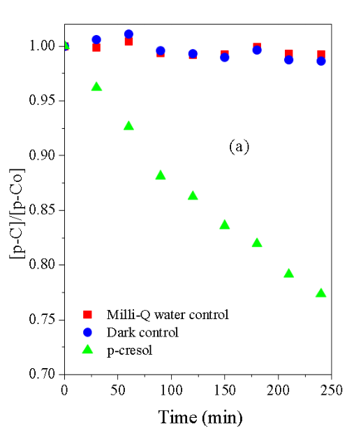
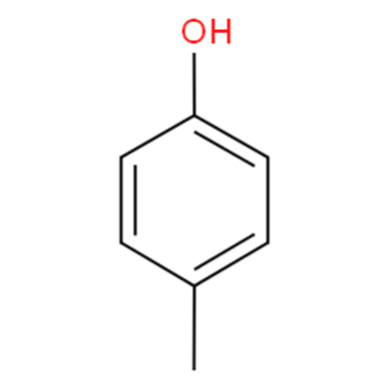
Background: Using sunlight to degrade organics in wastewater effluent
Bulleted Paragraph
  Bulleted Paragraph
p-Cresol degradation under direct sunlight for four hours
  Components:
    Sunlight
    Wastewater
    Oxygen
p-Cresol
Notes:
Mention singlet oxygen, sunlight and MB
Sunlight is actually doing something
Surrogate

Slide 6
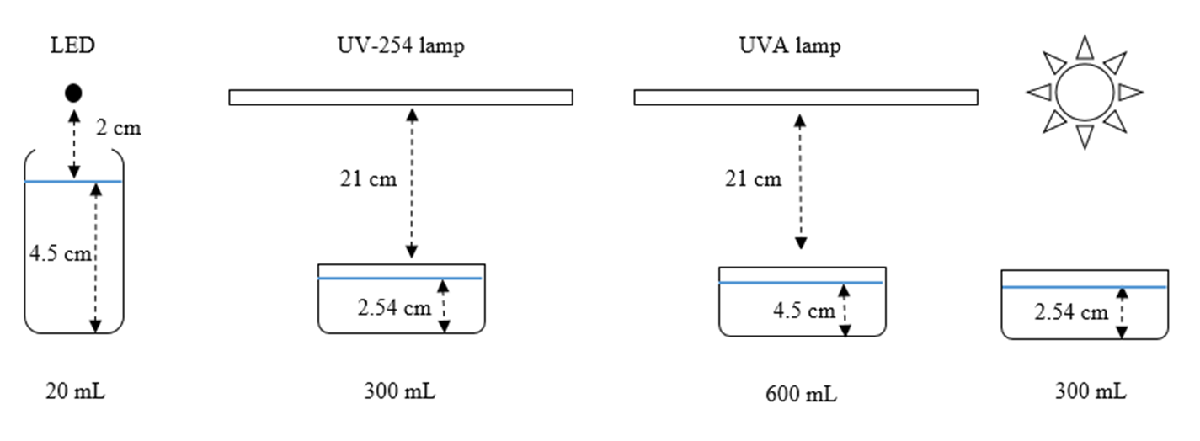
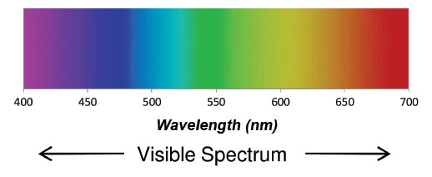
Experimental Setup
Notes:
Investigate sunlight:

Slide 7
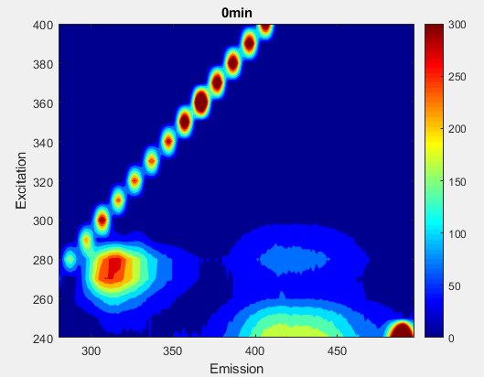
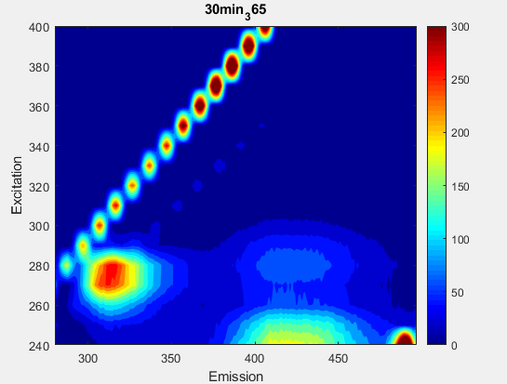
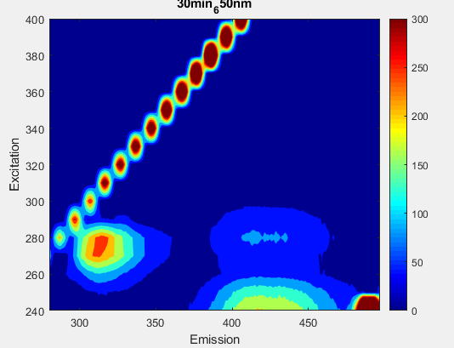
Results: Experimental Model (p-Cresol and Methylene Blue)
DI Water
30 minutes – Dark Control
DI Water
30 minutes – 650nm
5% degradation
DI Water
30 minutes – 365nm
6.5% degradation

Slide 8
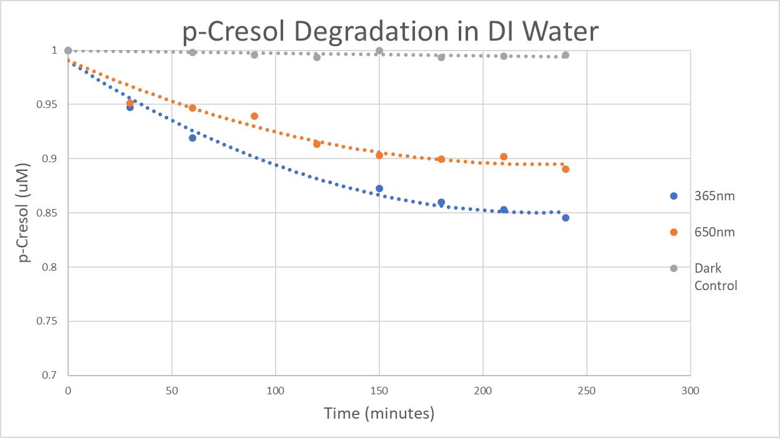
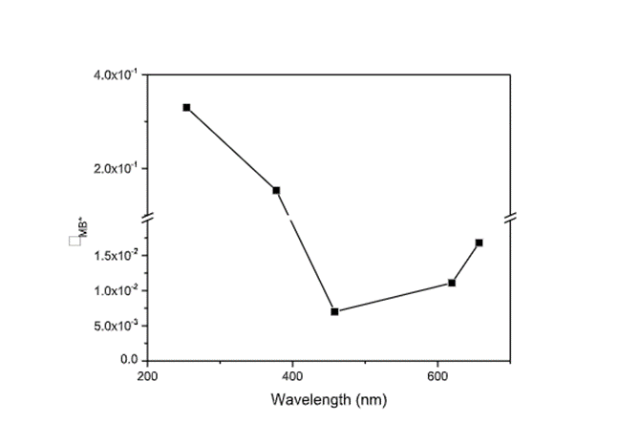
Results: Effectiveness of specific wavelength exposure
p-Cresol degradation under 365nm and 650nm LEDs
Notes:
Add P/Po
Moles reacted/moles absorbed
Wavelength Effectiveness – QY

Slide 9
Summary
Sunlight has the potential for wastewater reuse application
365nm and 650nm LED were capable of p-Cresol degradation upwards of 20% removal
Specific wavelengths of light could prove effective at precise contaminant removal

Slide 10
Questions?
Thank you to everyone in Dr. Saez’s Research Group for all the help and guidance on this journey.

